Slide 1
Biology Town Hall Meeting
March 6, 2017

Slide 2
Get Involved
Scientific Writing Workshop, 4:30-6pm April 5-6 at Writers House
Annual Biology Chair Cup Soccer Tournament, team registration deadline April 1st
Peer Mentor for 2017-2018 application deadline April 1st
Biology Retreat Team Leaders/Unit members.

Slide 3
Core Course Plan in BS in Biology (Freshmen)
General Biology 101
Freshmen
Sophomore
Junior
Senior
General Biology 102
Principles and Practices of Quantitative Biology
Principles and Practices of Biological Research
Elective courses

Slide 4
Career Development Course Plan in BS in Biology
Research
Medicine
Teaching
Non-Profit
For-Profit
Freshmen
Sophomore
Junior
Senior
Exploring Careers in Biology
Principles and Practices of Research
Special Problems in Biology (120:491)
Internship in Biology
Special Problems in Biology (120:492)
Thesis Honor in Biology
Special Problems in Biology / Co-Op (under development)

Slide 5
Joint Degree Programs in BS in Biology at Rutgers-Camden
Medicine
Research
Non-Profit
For-Profit
Freshmen
Sophomore
Junior
Senior
Professional School
BS/DO program with Rowan SOM
BS/MS
BS/MS in Forensic Biology
BA/MBA Accelerated program

Slide 6
BA/MBA
5yr accelerated program.
Biology Major and Business Administration Minor in 4 years.
Two-step admission process;
Admission to BA portion at the second year
Admission to MBA portion at the senior year
If you keep up the GPA 3.3, you can apply to MBA, and may waive 18 credits.
Students for preparing a career in managerial position in healthcare fields.

Slide 7
Two-step admission process
Second year
Applying to the BAMBA program
120M designation
Senior year
Start taking MBA classes
Applying to MBA program
Summer Internship
Summer Internship for work experience
Start taking business classes
MBA
Finishing up MBA courses

Slide 8
Proposed course plan
 | BA-MBA Dual Degree Program Recommended 5-Year Graduation Plan
 | Pre-Calc Math Placement
Year 1 | Fall Semester | Spring Semester
 | Eng Comp I (Gen Ed) | Eng Comp II (Gen Ed)
 | Biology 101 (Gen Ed Natural Sci) | Biology 102 (Gen Ed Natural Sci)
 | Precalculus (Gen Ed Quant Skills) | Calculus (Gen Ed Quant Skills)
 | Chemical Principles I | Chemical Principles II
 | Microeconomics (meets social science gen ed) | Macroeconomics(meets social science gen ed)
 | Summer
 | Introduction to Financial Accounting
 | Mangement Accounting
Year 2 | Fall Semester (Declare Bus Admin Minor w/ RSBC Advising) | Spring Semester
 | Organic Chemistry I | Organic Chemistry II
 | Biology Elective with Lab | Biology Elective with Lab
 | Principles and Practices of Quantitative Biology | Principles of Finance (Needs Special Permission RSBC)
 | Organizational Behavior | Principles of Marketing
 | General Education Requirement (Gen Ed. Civ & Her) | General Education Requirement (Gen Ed His/Phl/Rel)
 | Summer
 | General Physics I
 | General Physics II
Year 3 | Fall Semester (Apply to Dual Degree Program) | Spring Semester (Meet w/ MBA Advisor for SPN's for Fall MBA classes)
 | Biology Elective with Lab | Biology Elective with Lab
 | Biology Elective (i.e. 50:120: Writing Intensive) | Biology Elective
 | Operations Management (Needs Special Permission RSBC) | General Education Requirement (Gen Ed Lit & Fine Arts)
 | General Education Requirement (Gen Ed Lit & Fine Arts) | General Education Requirement (Gen Ed Global or Div)
 | General Education Requirement (i.e Foreign Language) | General Education Requirement (Gen Ed His/Phl/Rel)
 | Summer
 | GRE/GMAT Exam
Year 4 | Fall Semester (Submit Minor Certification Form) | Spring Semester (Complete GRAD School App)
 | Biology Elective with Lab | Biology Elective
 | Biology Elective | Current Topics in Biology
 | MBA | MBA
 | MBA | MBA
Year 5 | Fall Semester | Spring Semester
 | MBA | MBA
 | MBA | MBA
 | MBA | MBA
 | MBA | MBA

Slide 9
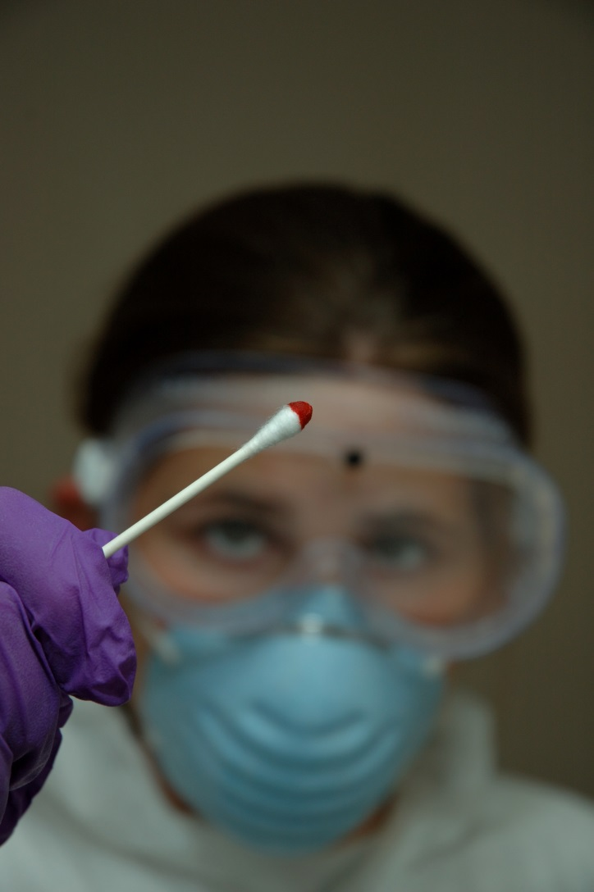
Forensic Biology
5yr accelerated BS/MS
For those interested in careers in forensic serology and DNA
FEPAC compliant program
Highly structured
Option to shift to a traditional 4yr BS + 2yr MS

Slide 10
Progress through the program – Freshman year

Slide 11
Progress through the program – Sophomore year

Slide 12
Progress through the program – Junior year

Slide 13
Progress through the program – Senior year

Slide 14
Progress through the program – Final year

